Slide 1
Embedded Systems
Introduction to Xilinx Vivado and ZYBO

Slide 2
Create Project
Create New Project in Vivado

Slide 3
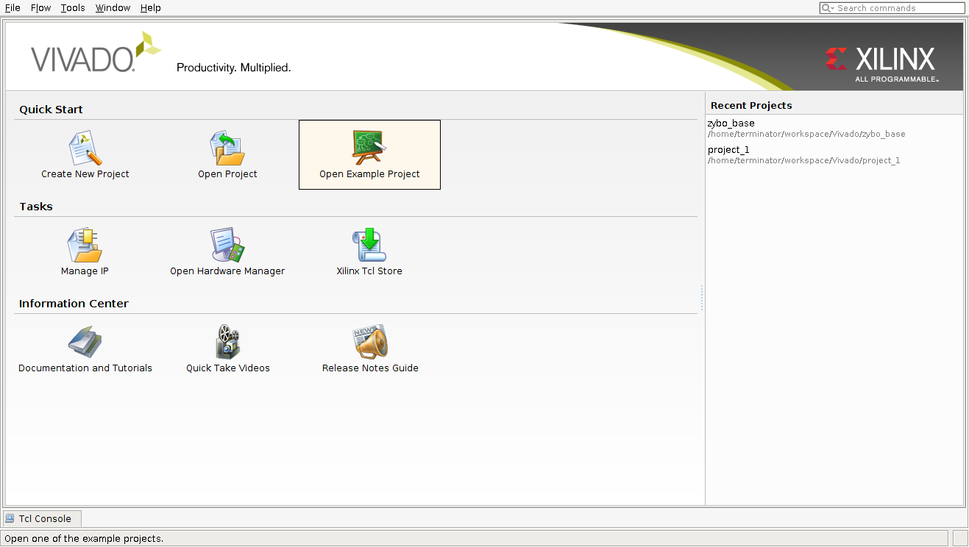
Create System Design
Create New Project:

Slide 4
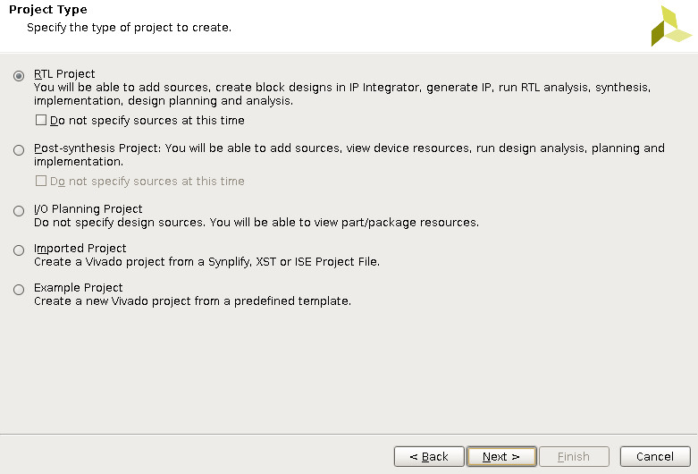
Create System Design
Create New Project:
Select RTL Project
Do not add any sources for now

Slide 5
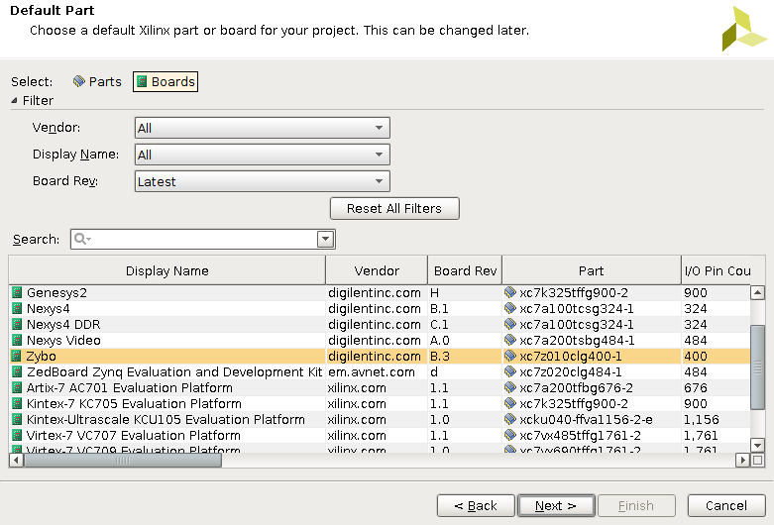
System Design
Create New Project:
Select System-on-Chip Zybo

Slide 6
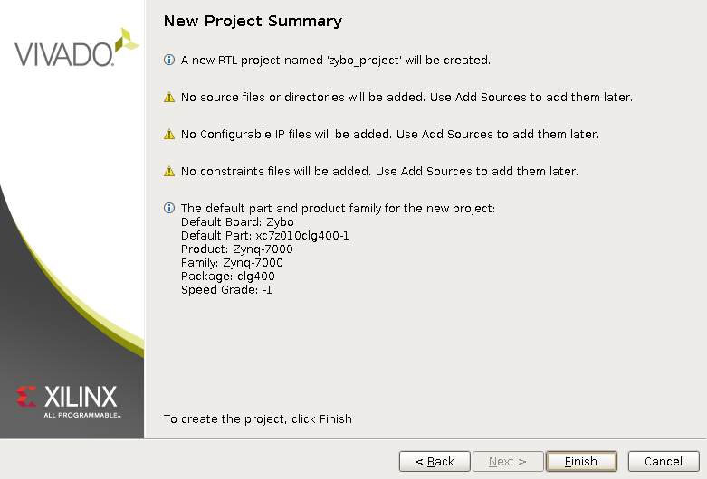
System Design
Create New Project:
Finish Project Configuration

Slide 7
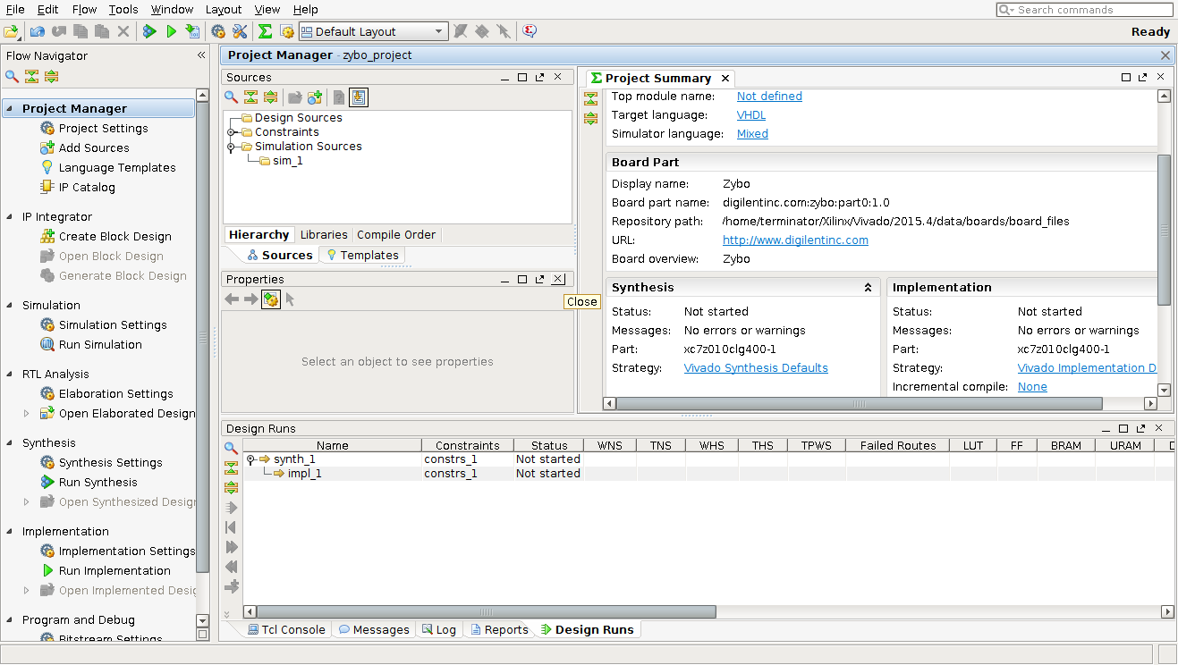
System Design
Setup Project:

Slide 8
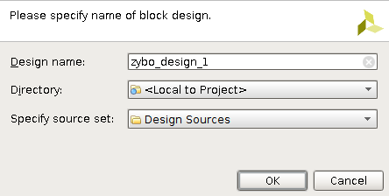
System Design
Setup Project:
Create Block Design

Slide 9
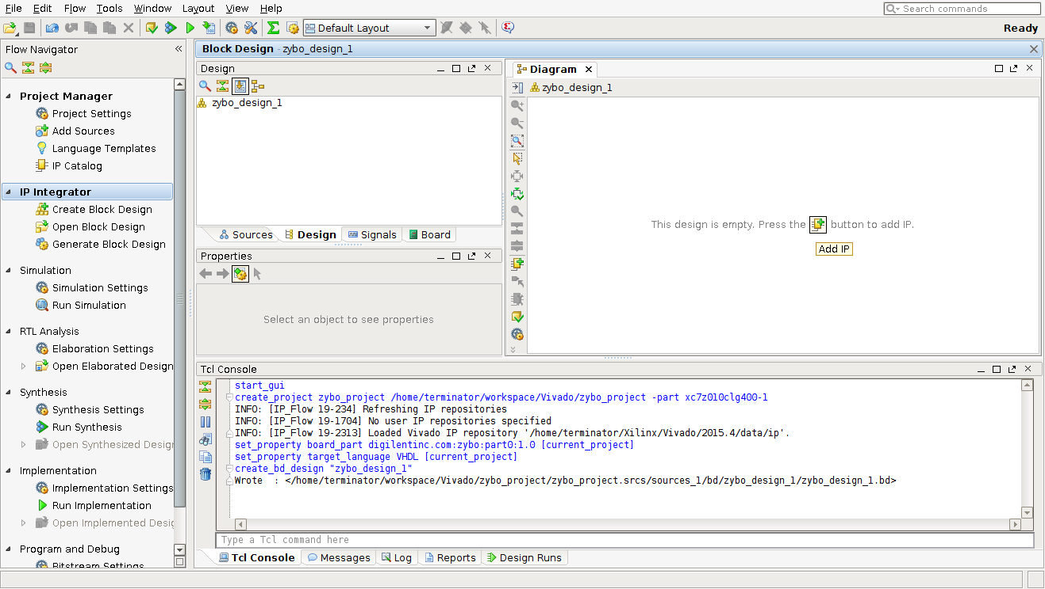
System Design
Setup Project:
Add IP

Slide 10
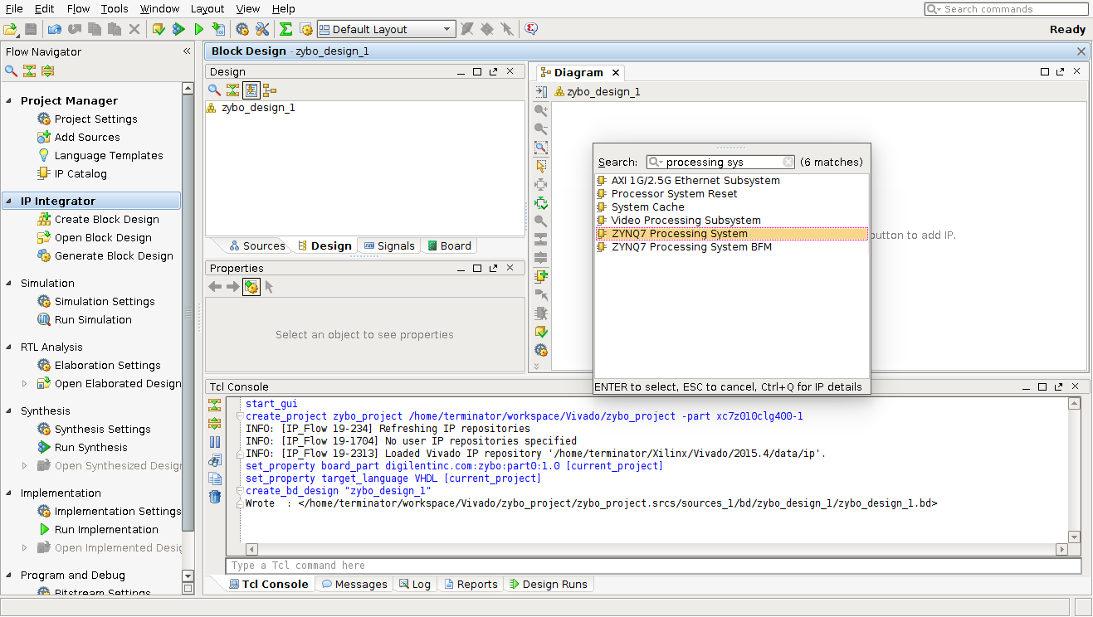
System Design
Setup Project:
Add Zynq7 Processing System

Slide 11
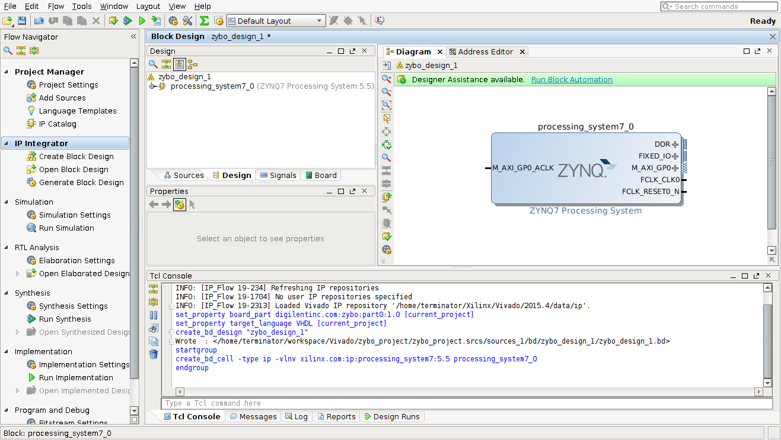
System Design
Setup Project:
Run Block Automation

Slide 12
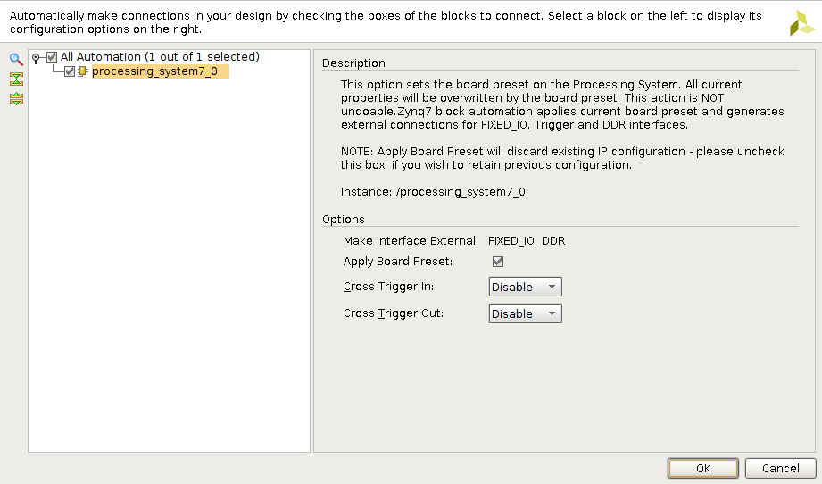
System Design
Setup Project:
Apply the Board Preset

Slide 13
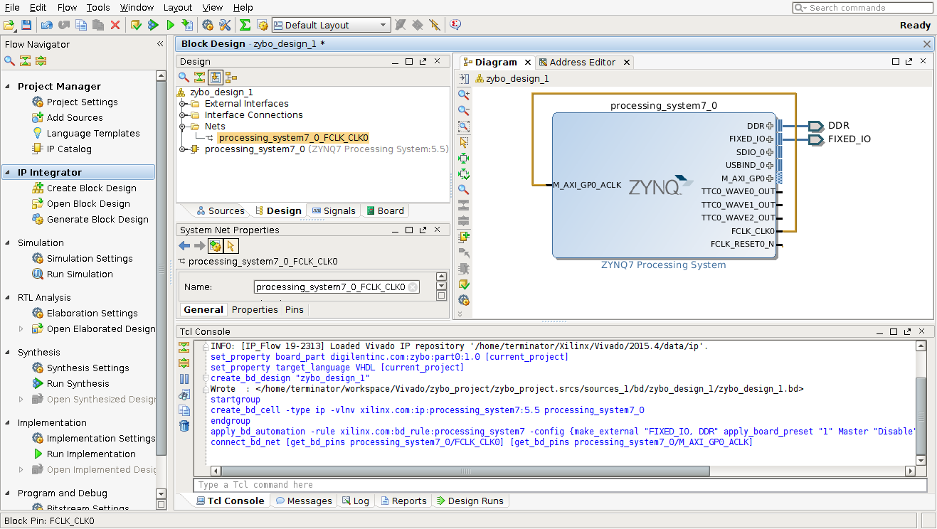
System Design
Setup Project:
Feed the PS clock to the FPGA AXI Bus

Slide 14
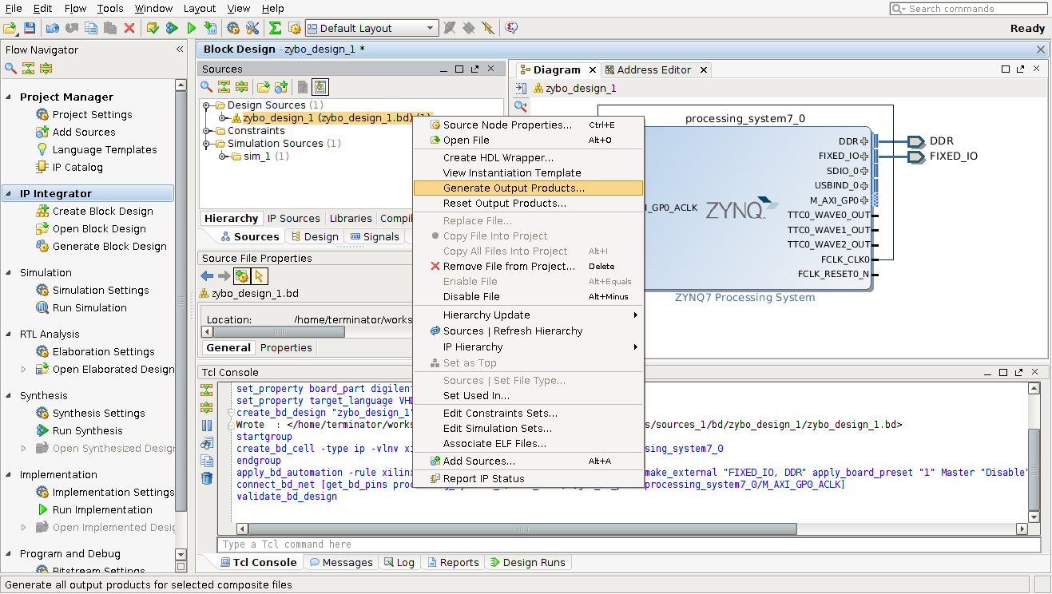
System Design
Setup Project:
Generate Output Products (Right-Click on Block Design)

Slide 15
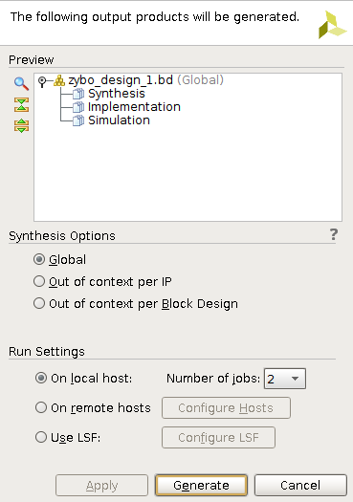
System Design
Setup Project:
Generate Output Products

Slide 16
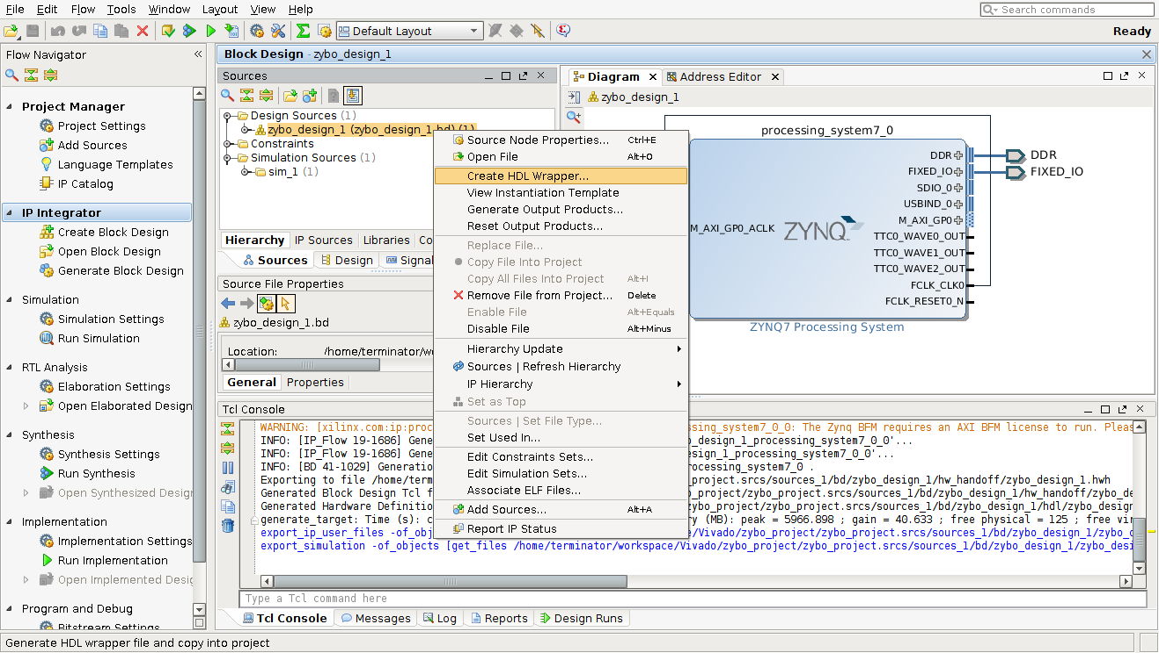
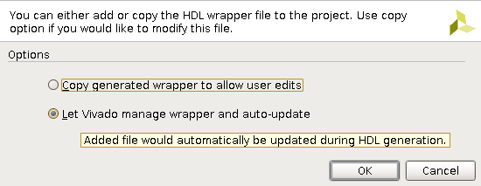
System Design
Setup Project:
Create HDL Wrapper (Right-Click on Block Design)
Let Vivado manage wrapper and auto-update

Slide 17
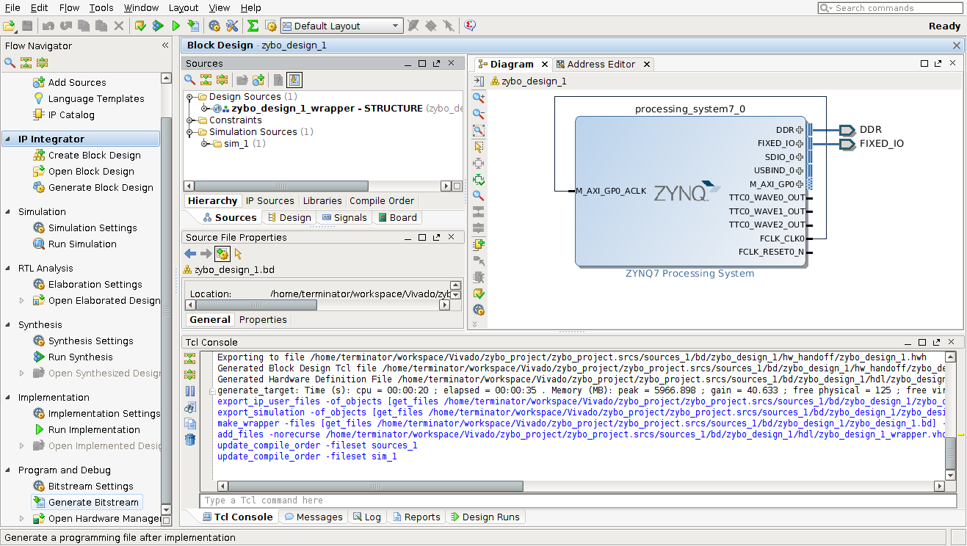
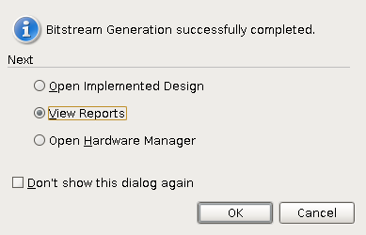
System Design
Setup Project:
Generate Bitstream
2º
1º

Slide 18
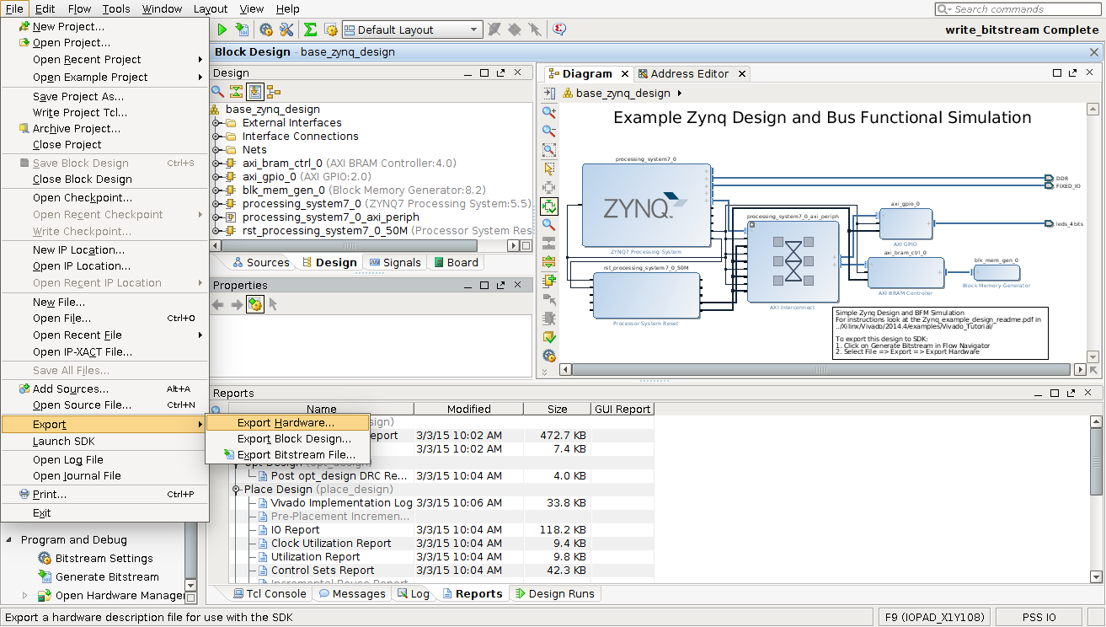
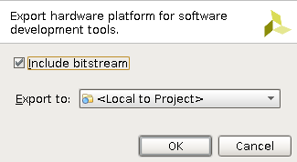
System Design
After the Bitstream generation:
Export Hardware (Include Bitstream)
Launch SDK
2º
1º
3º

Slide 19
Create Project
Create New SW Application

Slide 20
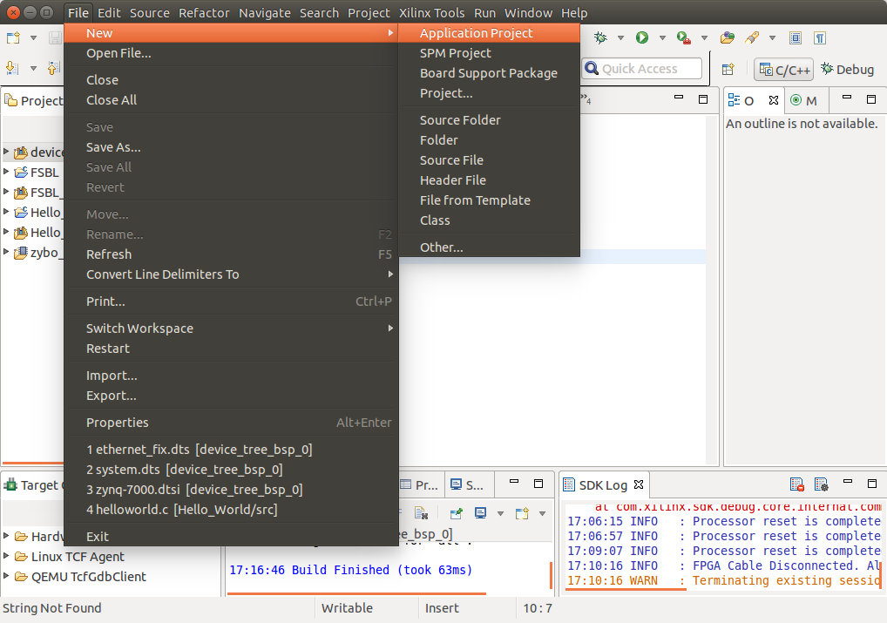
Software Application
Create Hello World Application:
Create New Application Project
[File → New → Application Project]

Slide 21
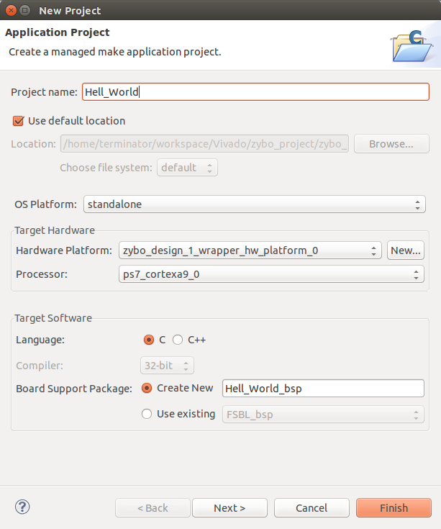
Software Application
Create Hello World Application:
Select Project Name and Click Next
1º
Hardware Platform Exported from Vivado
2º

Slide 22
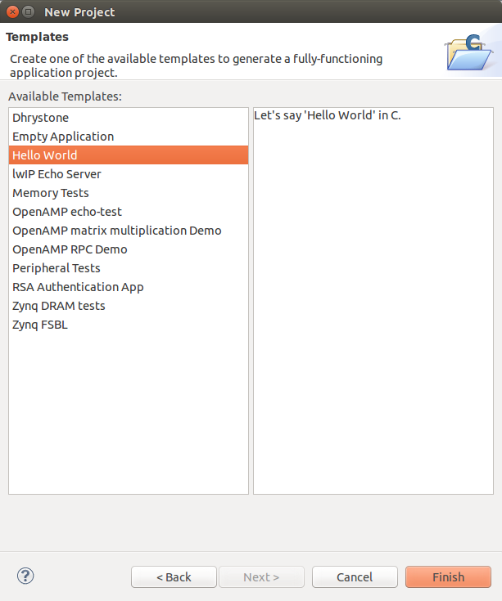
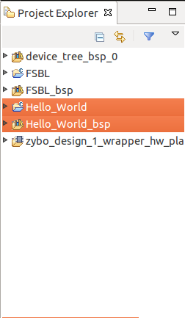
Software Application
Create Hello World Application:
Select Hello World Template
Finish
1º
3º
2º

Slide 23
Software Application
Connect Xilinx Zybo development platform to the Host PC via JTAG-UART
Add permissions to user:
bash$ sudo gpasswd –add $USER dialout
Log out and log back in for the changes to take effect

Slide 24
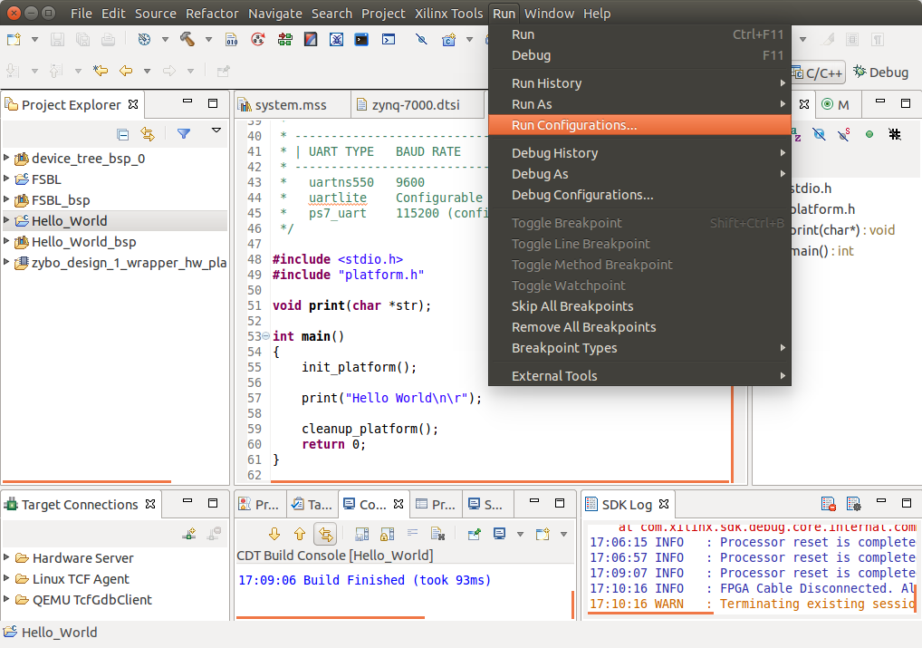
Software Application
Setup Run Configurations:
Select “Hello_World” Project
Select Run → Run Configurations
2º
1º

Slide 25
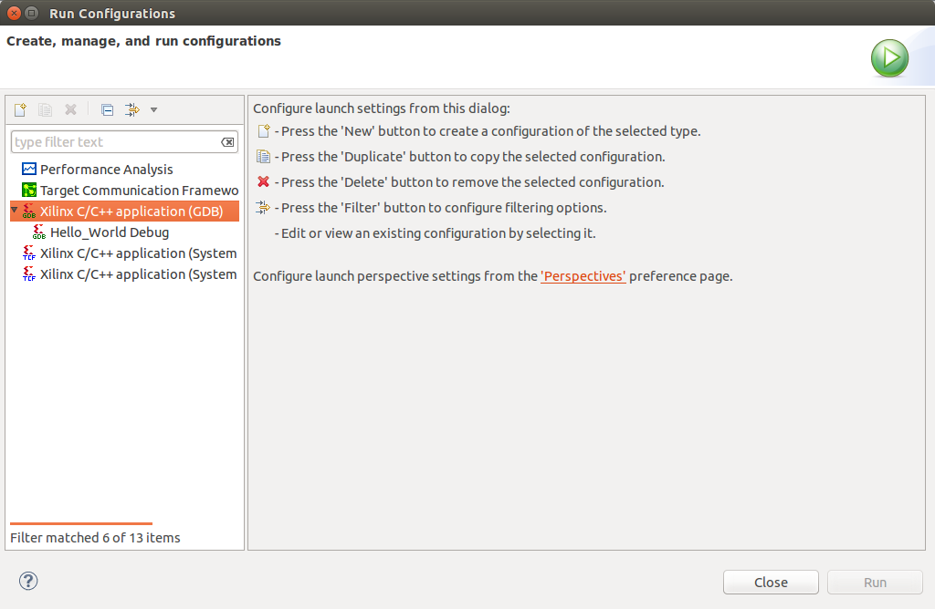
Software Application
Setup Run Configurations:
Double-Click Xilinx C/C++ application (GDB)

Slide 26
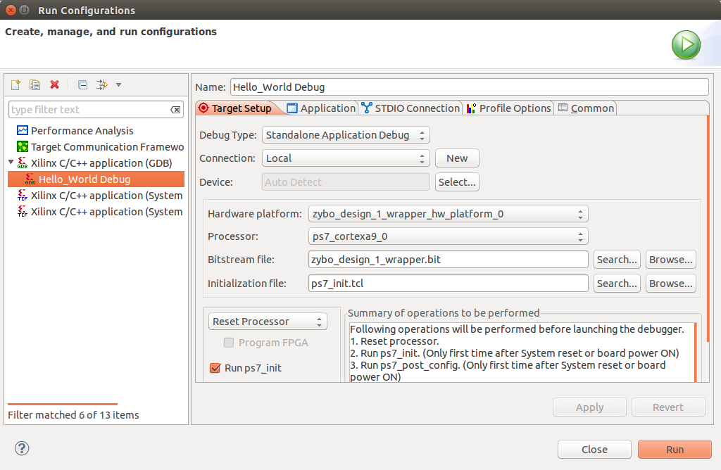
Software Application
Setup Run Configurations:
Setup Target Setup [Done Automatically]

Slide 27
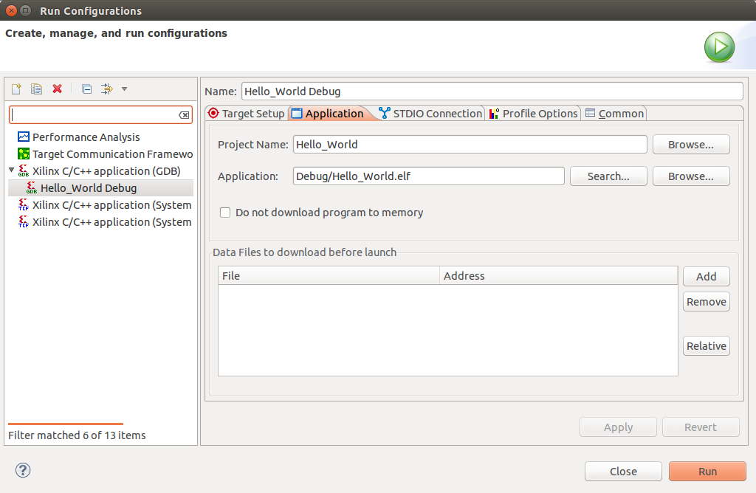
Software Application
Setup Run Configurations:
Setup Hello World Application [Done Automatically]

Slide 28
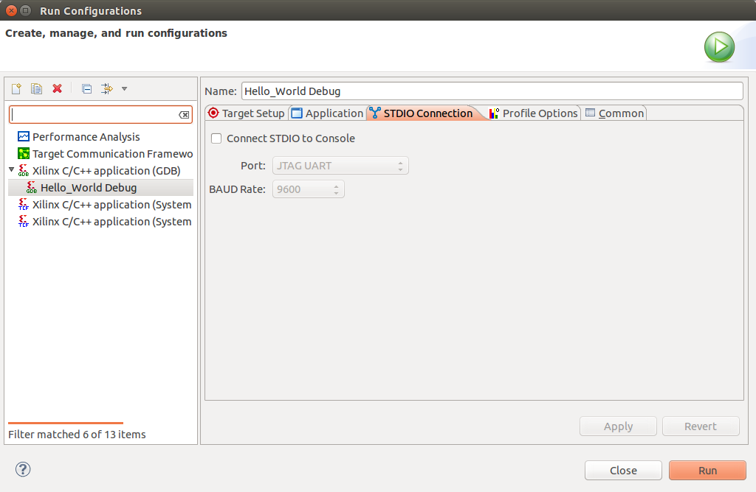
Software Application
Setup Run Configurations:
Setup STDIO Connection
Connect STDIO to Console
Port = JTAG UART & Baudrate = 115200
Apply Settings

Slide 29
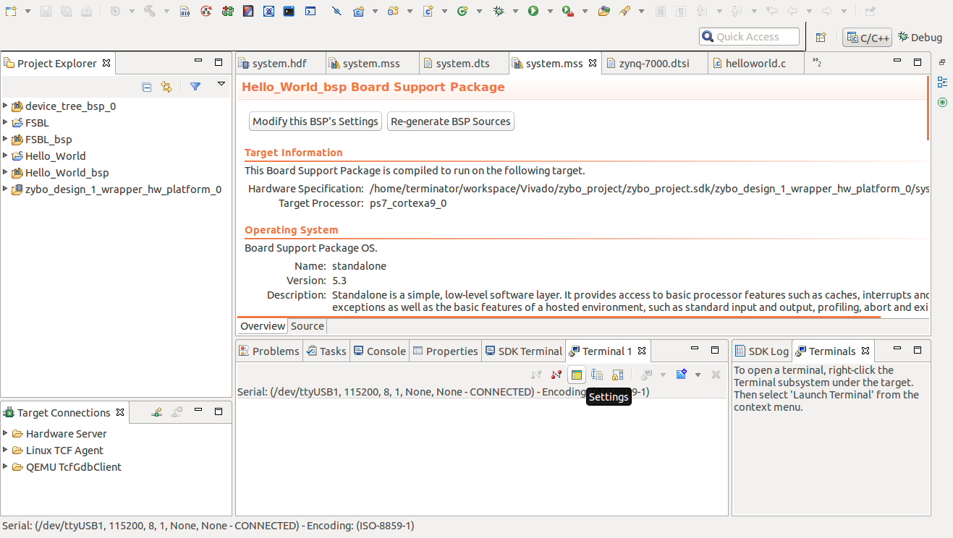
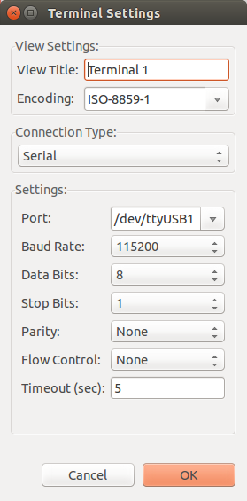
Software Application
Setup Run Configurations:
Setup Terminal Settings
Select Platform Port
If it isn’t visible go to:
Window → Show View → Other → Terminal
Notes:
export GTK_NATIVE_WINDOWS=1 && sudo gpasswd –add $USER dialout

Slide 30
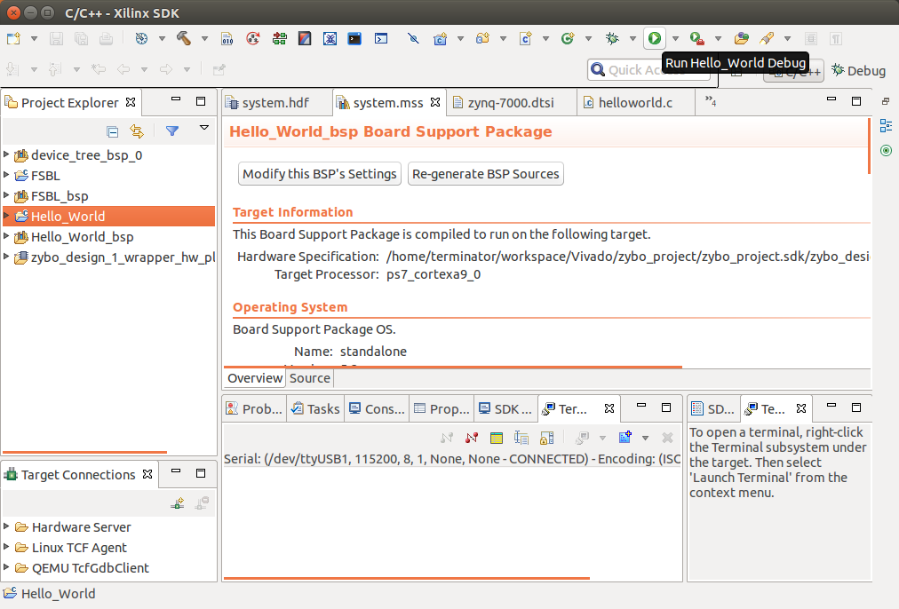
Software Application
Run Application:
Run “Hello_World” Application

Slide 31
Create IP-Core
Create and Package Peripheral in Vivado

Slide 32
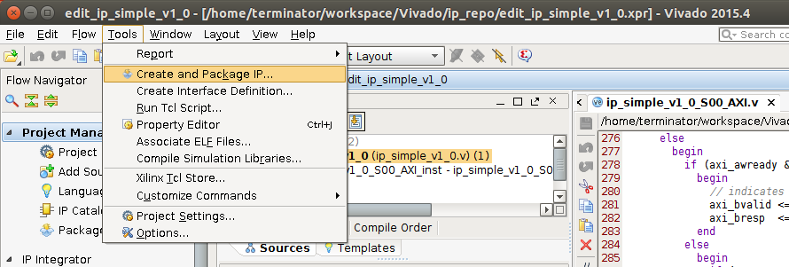
Create IP-Core
With the base Vivado project opened, from the menu select Tools → Create and Package IP.

Slide 33
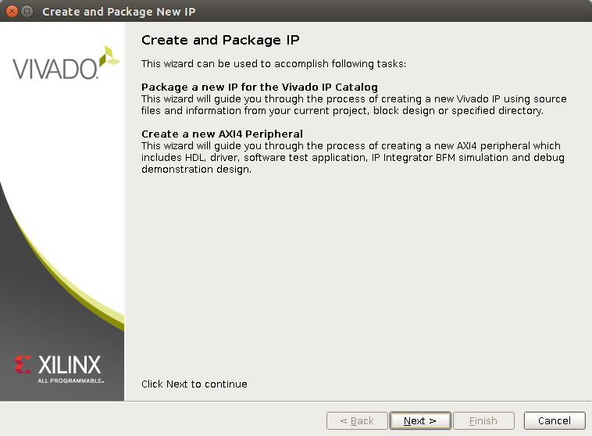
Create IP-Core
Create/Import Peripheral wizard. Click Next.

Slide 34
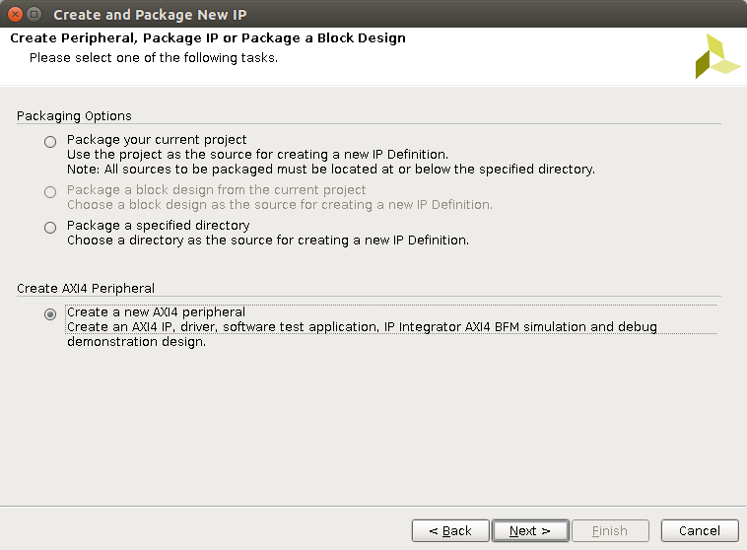
Create IP-Core
Create a new AXI4 Peripheral.

Slide 35
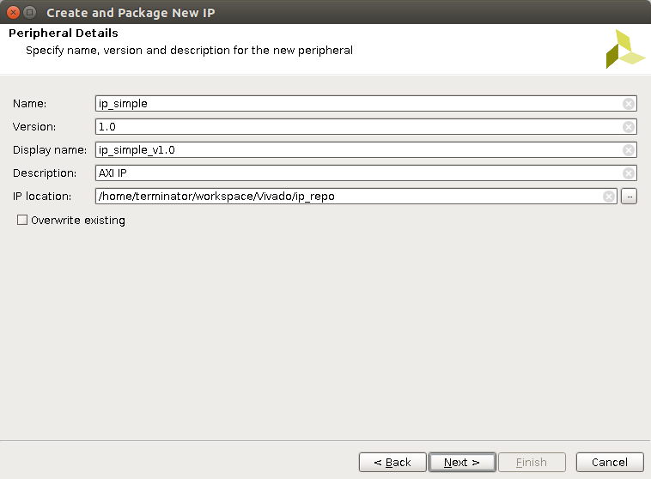
Create IP-Core
Set the Peripheral’s details.

Slide 36
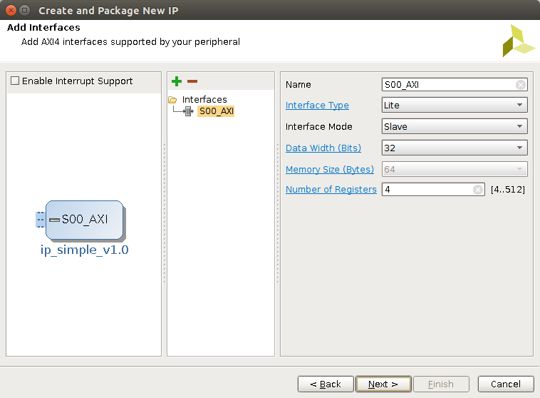
Create IP-Core
Add an AXI Lite Slave interface with 4 configurable 32‑bits registers.

Slide 37
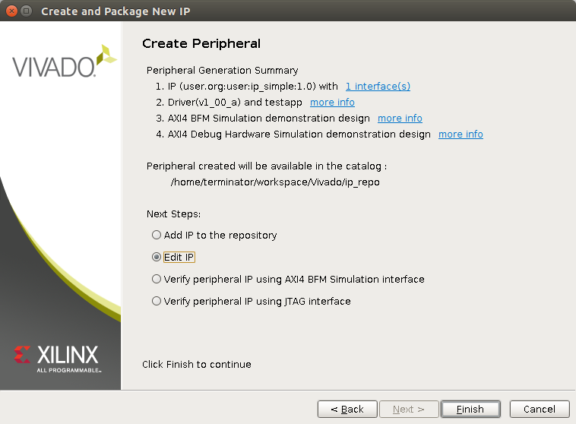
Create IP-Core
Edit IP Peripheral in a new Vivado Project.

Slide 38
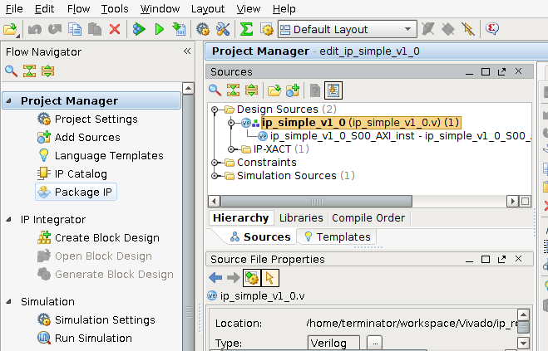
Package IP-Core
Click on Package IP.

Slide 39
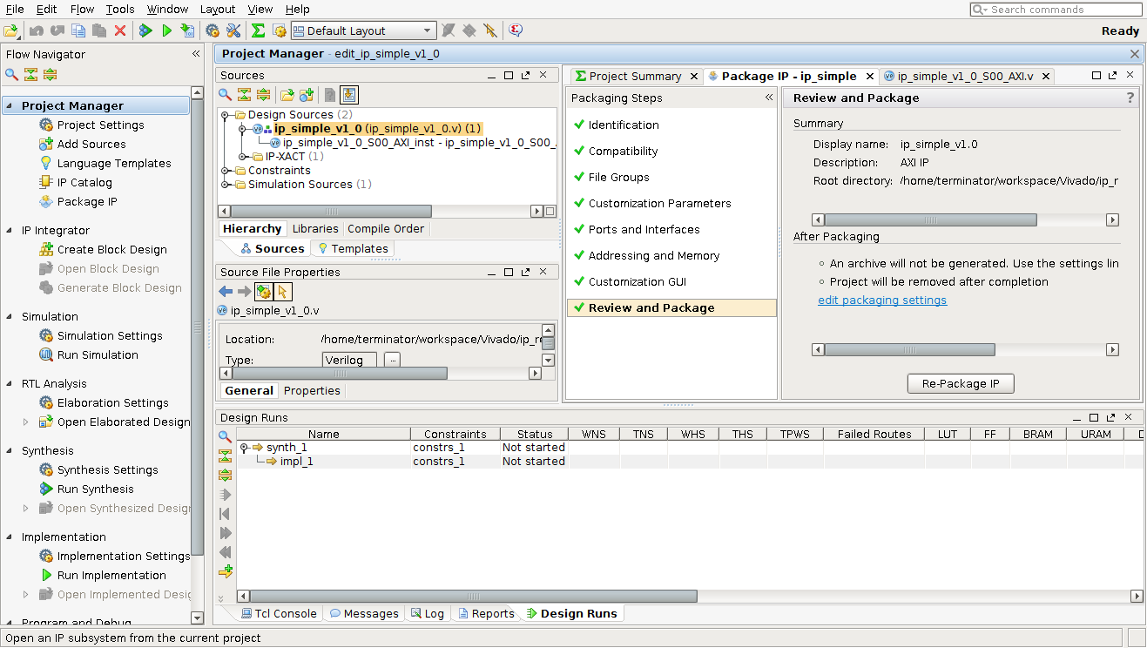
Package IP-Core
Select Re-Package IP-core.

Slide 40
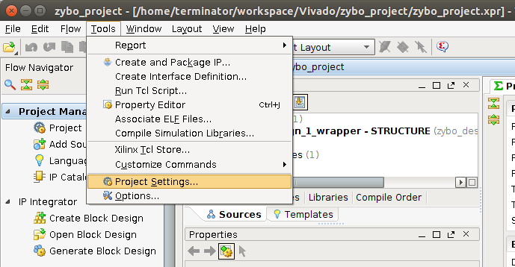
Add IP-Core Repository to Project
Edit Project Settings
Tools → Project Settings…

Slide 41
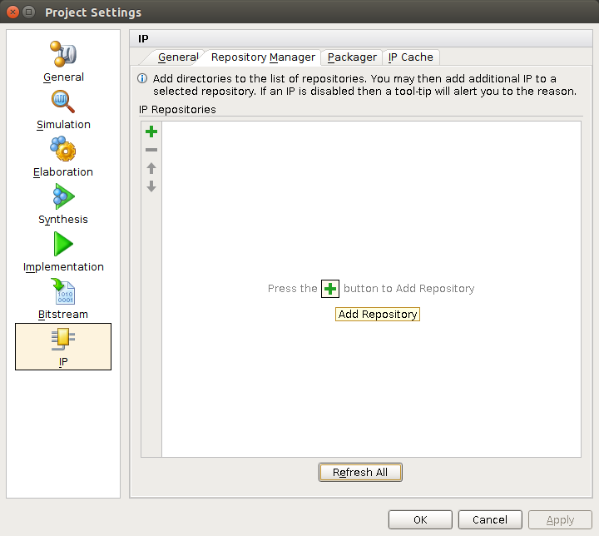
Add IP-Core Repository to Project
Edit Project Settings
Select IP → Repository Manager → Add Repository

Slide 42
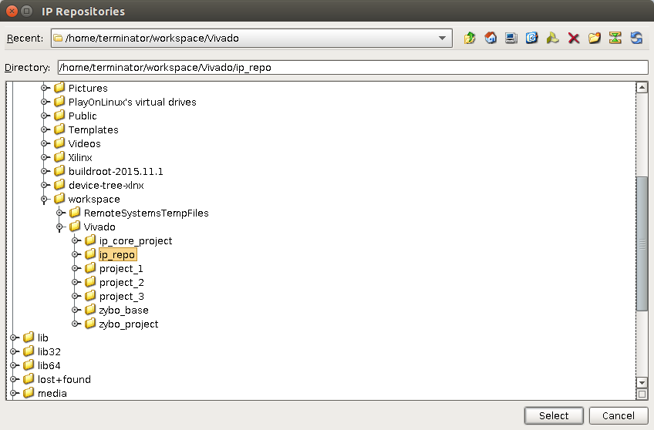
Add IP-Core Repository to Project
Add IP Repository
Select IP Repository Project folder

Slide 43
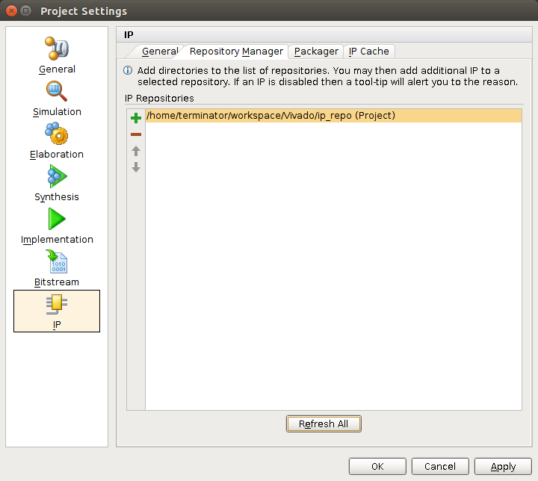
Add IP-Core Repository to Project
Add IP Repository by Clicking OK

Slide 44
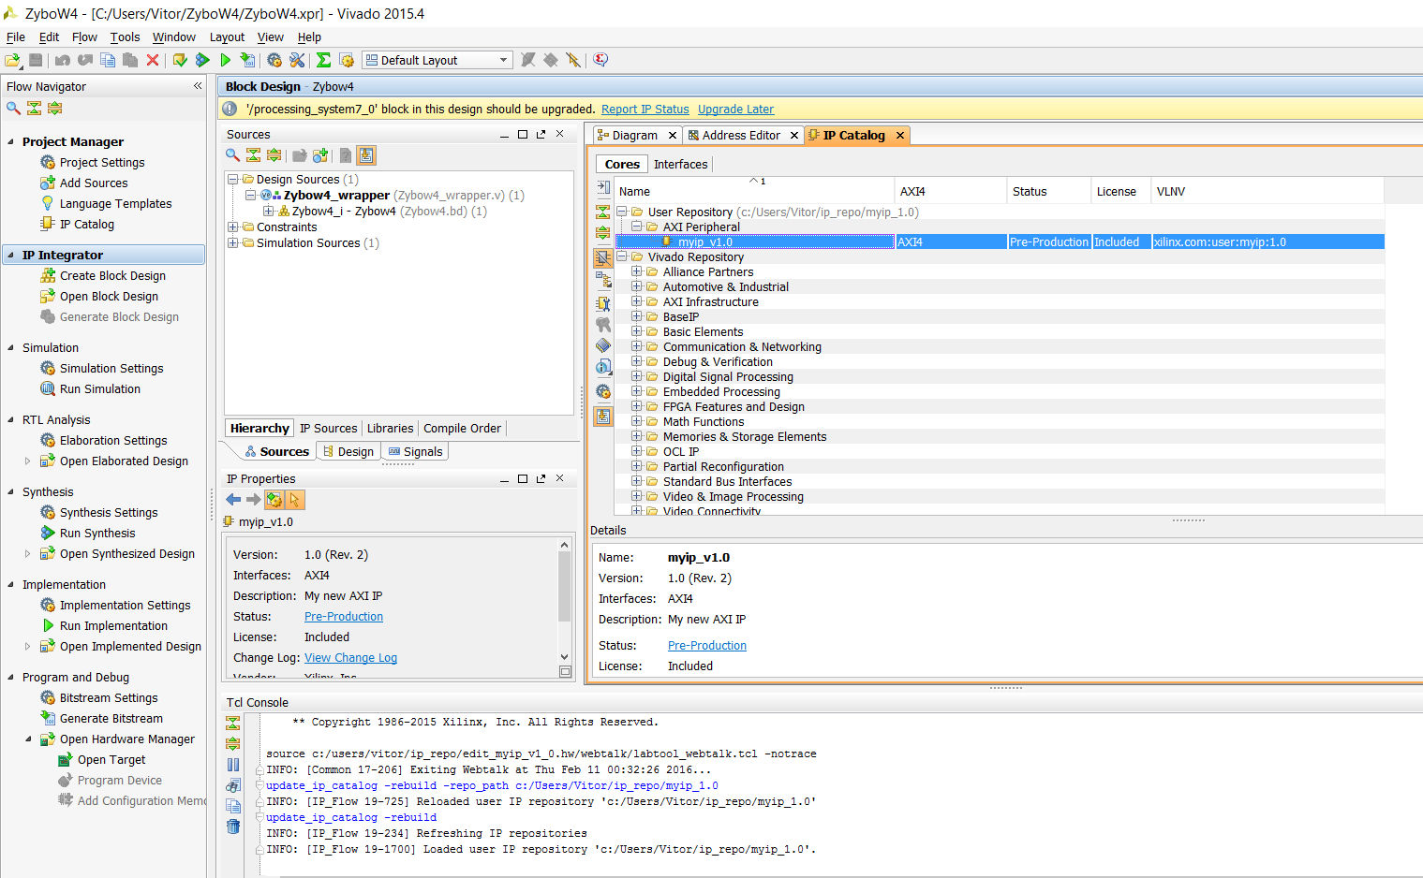
Add IP-Core to Block Design
Click on IP Catalog and choose your CustomIP

Slide 45
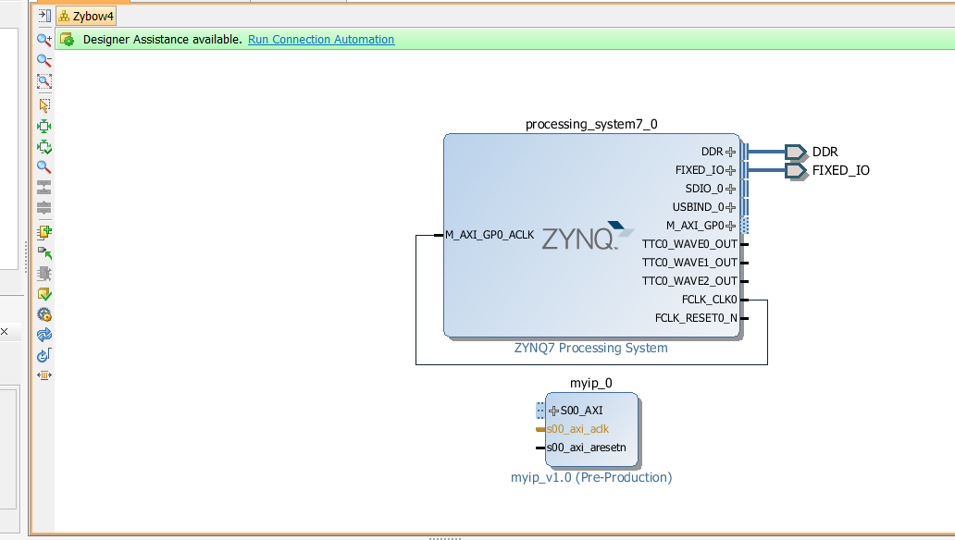
Add IP-Core to Block Design
Click on Run Connection Automation
CustomIP

Slide 46
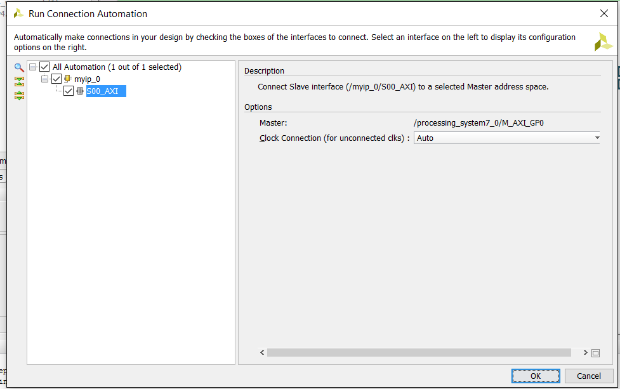
Connection Automation
Click OK to connect the IP-core to the Processing System

Slide 47
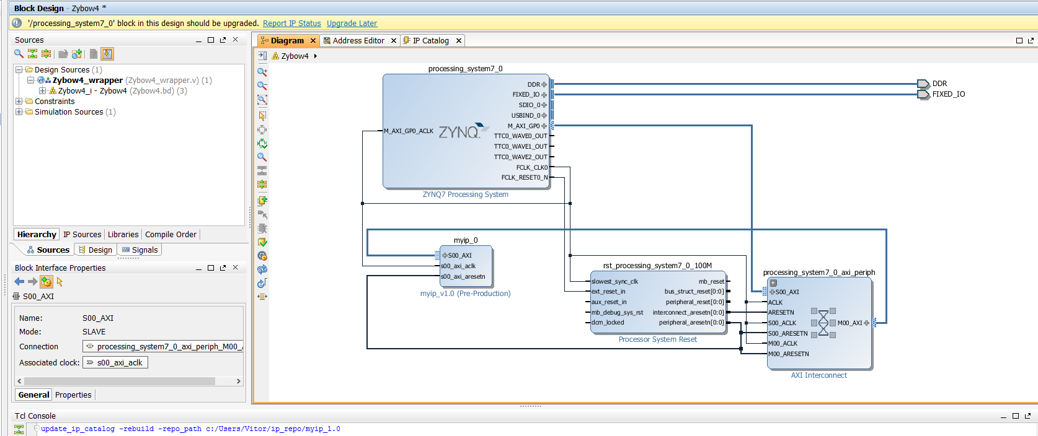
Zybo System Design
It generated a Processor System Reset and an AXI Interconnect to make the AXI interface
Processing System
AXI Interconnect
Custom IP
Processor System Reset

Slide 48
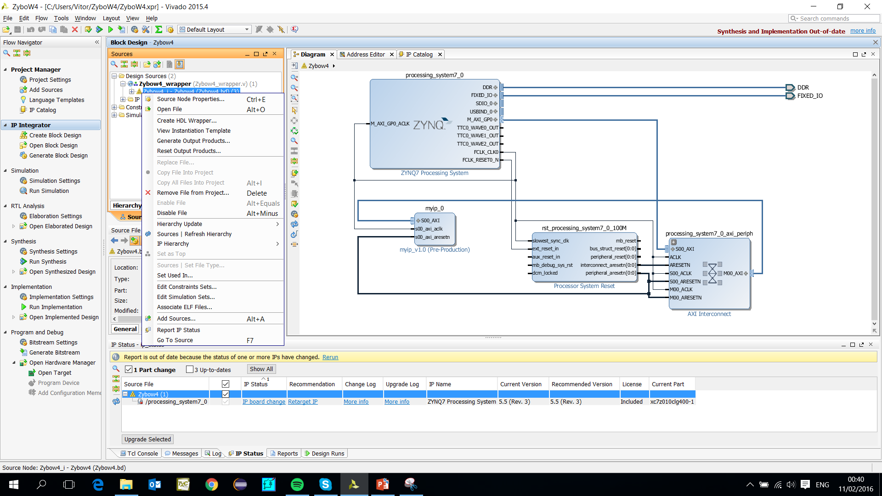
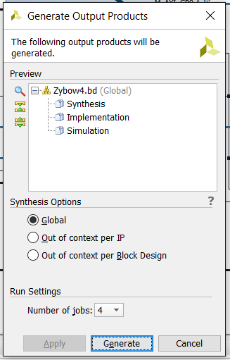
Zybo System Design
Generate Output Products and Create HDL Wrapper
2º
1º

Slide 49
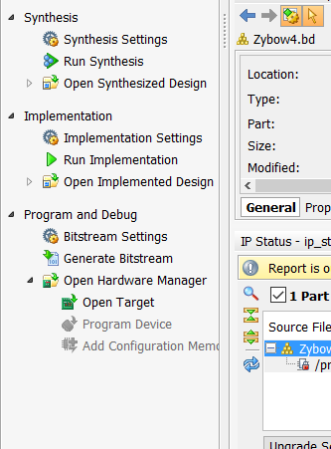

Zybo System Design
Click on Generate Bitstream
Completed

Slide 50


Zybo System Design
Export Hardware
File → Export → Export Hardaware

Slide 51

Zybo System Design
Launch Software Development Kit
File → Launch SDK
Typical Location is:
$Projects_Folder/<Project>/<Project>.sdk

Slide 52


Hardware Platform
The system.hdf file shows the information of the peripherals of the hardware platform
Address Map

Slide 53

Create Custom IP Selftest Application
Create New Application
File → New → Application Project

Slide 54


Create Custom IP Selftest Application
Select Project Name and Hello World Template
1º
2º
Hardware Platform Exported from Vivado
3º

Slide 55

Create Custom IP Selftest Application
The Custom IP drivers are generated by the BSP
Application Project
Board Support Package

Slide 56

Create Custom IP Selftest Application
Modify the “helloworld.c” in |CustomIP → src|:
Add Custom IP header file
Contains Peripheral’s Address
Call Selftest Function from “my_ip.h”

Slide 57

Create Custom IP Selftest Application
The Peripheral’s Address is in BSP folder:
CustomIP_BSP → ps7_cortexa9_0 → include → xparameters.h

Slide 58
Vivado + Zybo
END

